Slide 1
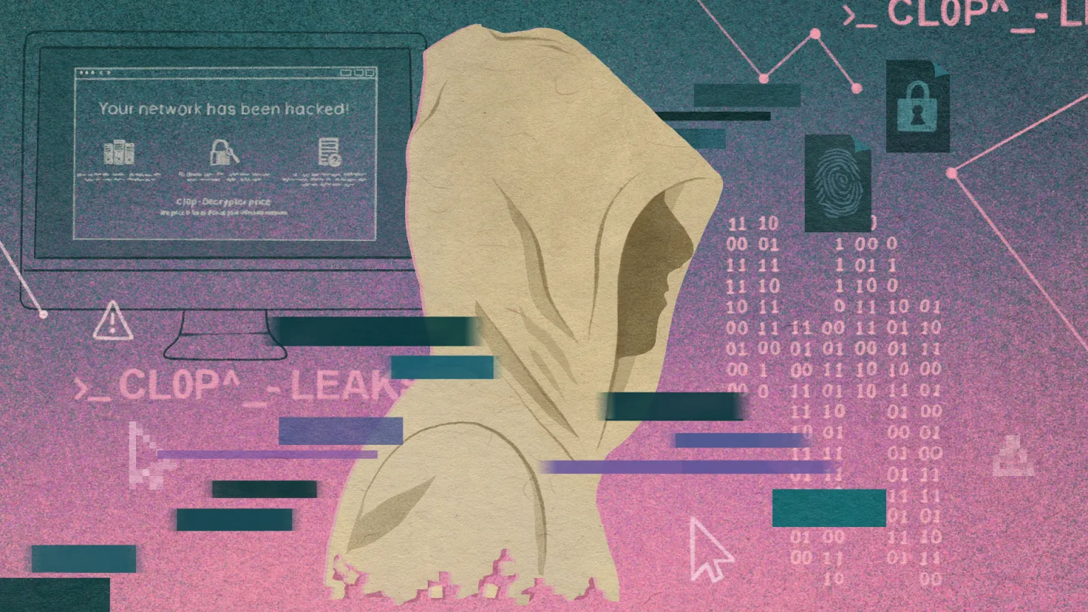

CL0P Case Study
Brandon Trinkle
Louie Andrade
Zack Fetter
William Turton
Notes:
Today, my colleagues Louie Andrade, Zack Fetter, William Turton, and I will be presenting our case study on the CL0P ransomware group. We'll explore what ransomware is, how it works, and specifically how CL0P operates. We aim to provide a clear understanding of these attacks, their impact, and how organizations can protect themselves.

Slide 2

What is Ransomware?
Definition
Malicious software that encrypts data, demanding payment for decryption.
Impact:
Causes financial loss, operational downtime, and reputational damage.
Growing Threat:
Increasingly targets critical sectors and uses sophisticated methods.
Notes:
Let’s start with understanding what ransomware is. Ransomware is a type of malicious software designed to encrypt data, rendering it inaccessible until a ransom is paid for decryption. The impact of these attacks can be quite severe—they can cause major financial loss, operational downtime, and long-term reputational damage. Unfortunately, ransomware is a growing threat, as it increasingly targets critical sectors, like healthcare, education, and government. Attackers are also becoming more sophisticated, employing advanced techniques to make these attacks harder to detect and prevent.
The reason ransomware is such a growing problem is due to a combination of the ease of accessing ransomware-as-a-service kits and the lucrative potential of these attacks. With large organizations often paying hundreds of thousands or even millions of dollars to recover their data, the incentives are strong for attackers to continue targeting vulnerable systems.

Slide 3

How Ransomware Works?
Infection Methods
Phishing, exploiting vulnerabilities, malicious downloads.
Attack Process
Initial access, data encryption, ransom demand, potential data leak.
Defense Strategies
Layered security, regular patching, employee training, backups.
Notes:
Now, let's delve into how ransomware typically works. It all starts with infection methods—common avenues include phishing emails, exploiting vulnerabilities in outdated software, or tricking victims into downloading malicious files. Once the attackers gain initial access, the real damage begins. They encrypt the victim's data and demand a ransom. In many cases, attackers also threaten to leak sensitive information if their demands aren’t met. This is what we call "double extortion."
Defending against ransomware requires a multi-layered approach. Layered security systems can help, such as firewalls, endpoint protection, and intrusion detection tools. Regular patching of software vulnerabilities is also crucial, as well as employee training to reduce the risk of successful phishing attacks. Regular backups are a vital last line of defense to ensure that data can be restored without paying a ransom.

Slide 4

CL0P Ransomware
Overview
CL0P is a human-operated ransomware group targeting enterprise systems.
Notable Attacks
2023 attacks on GoAnywhere MFT & Moveit, leveraging critical vulnerabilities.
Tactics
Zero-day exploitation, SQL injection, double extortion methods.
Notes:
Moving on to CL0P ransomware, this is a human-operated group that has gained a lot of attention due to its high-profile attacks on enterprise systems. What makes CL0P different from the rest is the scale and precision of their attacks. For instance, in 2023, CL0P exploited vulnerabilities in widely used file transfer systems like GoAnywhere MFT and MOVEit. These attacks affected hundreds of organizations, from private enterprises to government entities.
CL0P is known for using zero-day vulnerabilities—those that were unknown before the attack—alongside other tactics like SQL injections and double extortion. Their focus is on extracting the most value out of each target by using a mix of technical and psychological pressure to ensure their ransom is paid.

Slide 5

CL0P Attack Methods
Exploitation Techniques
Uses phishing and exploits vulnerabilities in enterprise file transfer systems.
Operational Scale
Often affects hundreds of organizations at once.
Impact & Mitigation
Emphasizes early detection, network segmentation, and prompt patching.
Notes:
The key to CL0P's success lies in their well-coordinated exploitation techniques. They start with phishing to gain initial access or use vulnerabilities in enterprise file transfer systems, allowing them to infiltrate and spread quickly. Once inside, they encrypt large volumes of data and then demand ransom from hundreds of affected organizations.
CL0P’s impact is significant because of its operational scale—it’s not just about a single company being hit; it's often about multiple companies, which makes the aftermath much harder to deal with. To mitigate such attacks, it's essential to have early detection mechanisms. Network segmentation is another effective measure—limiting the spread of ransomware if one part of the network is compromised. Prompt patching is also crucial to ensure that vulnerabilities are closed as soon as they are discovered.

